Slide 1
How do we sense the world as a child?

Slide 2
Sensations can be defined as the passive process of bringing information from the outside world into the body and to the brain. .Perception can be defined as the active process of selecting, organizing, and interpreting the information brought to the brain by the senses.

Slide 3
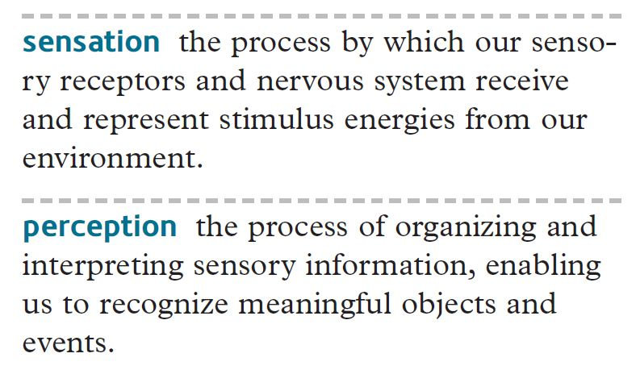

Slide 4
A) HOW THEY WORK TOGETHER:
1) Sensation occurs:
a) sensory organs absorb energy from a physical stimulus in the environment.
b) sensory receptors convert this energy into neural impulses and send them to the brain.
2) Perception follows:
a) the brain organizes the information and translates it into something meaningful.

Slide 5
B) But what does "meaningful" mean? How do we know what information is important and should be focused on?
1) Selective Attention - process of discriminating between what is important & is irrelevant (Seems redundant: selective-attention?), and is influenced by motivation.
For example - students in class should focus on what the teachers are saying and the overheads being presented. Students walking by the classroom may focus on people in the room, who is the teacher, etc., and not the same thing the students in the class.

Slide 6

1. Visual Perception
Process used to organize sensory impressions caused by the light that strikes our eyes
Sensation is a mechanical process
Perception is an active process
Involves experience, expectations and motivations

Slide 7

1. Visual Perception
Process used to organize sensory impressions caused by the light that strikes our eyes
Sensation is a mechanical process
Perception is an active process
Involves experience, expectations and motivations

Slide 8
2) Perceptual Expectancy - how we perceive the world is a function of our past experiences, culture, and biological makeup.
example - you may look at a painting and not really understand the message the artist is trying to convey. But, if someone tells you about it, you might begin to see things in the painting that you were unable to see before.

Slide 9
ALL OF THIS IS CALLED Psychophysics
C) Psychophysics can be defined as, the study of how physical stimuli are translated into psychological experience.
In order to measure these events, psychologists use THRESHOLDS.
1) Threshold - a dividing line between what has detectable energy and what does not.

Slide 10
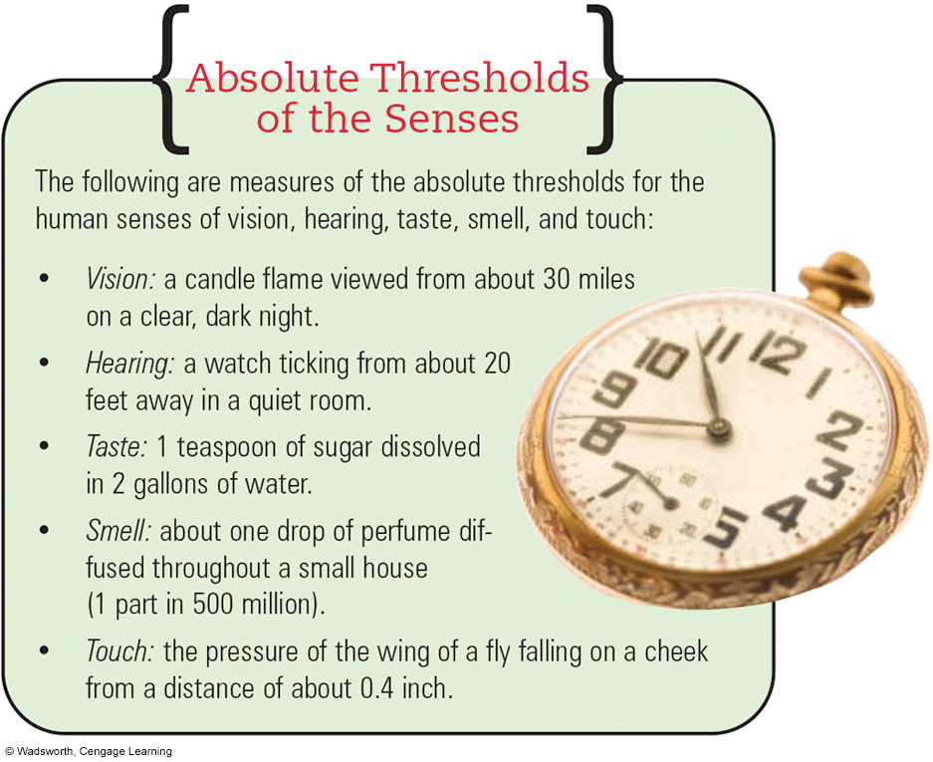
2. Absolute Threshold
Weakest amount of a stimulus that can be distinguished from no stimulus at all
Detected 50% of the time
Notes:
Truth or Fiction? If we could see waves of light with slightly longer wavelengths, warm-blooded animals would glow in the dark. TRUE If you could see light with slightly longer wavelengths, you would see infrared light waves. Since heat generates infrared light, warm-blooded people, including other people would glow in the dark.
Vision – a candle flame viewed from about 30 miles on a clear night
Hearing – a watch ticking from about 20 feet away in a quiet room
Taste – 1 teaspoon of sugar dissolved in 2 gallons of water
Smell – about one drop of perfume diffused though a small house
Touch – the pressure of the wing of a fly falling on a check about a distance of about .4 inch

Slide 11
2) Difference Threshold - the minimum amount of stimulus intensity change needed to produce a noticeable change.
the greater the intensity (ex., weight) of a stimulus, the greater the change needed to produce a noticeable change.
For example, when you pick up a 5 lb weight, and then a 10 pound weight, you can feel a big difference between the two. However, when you pick up 100 lbs, and then 105 lbs, it is much more difficult to feel the difference.

Slide 12
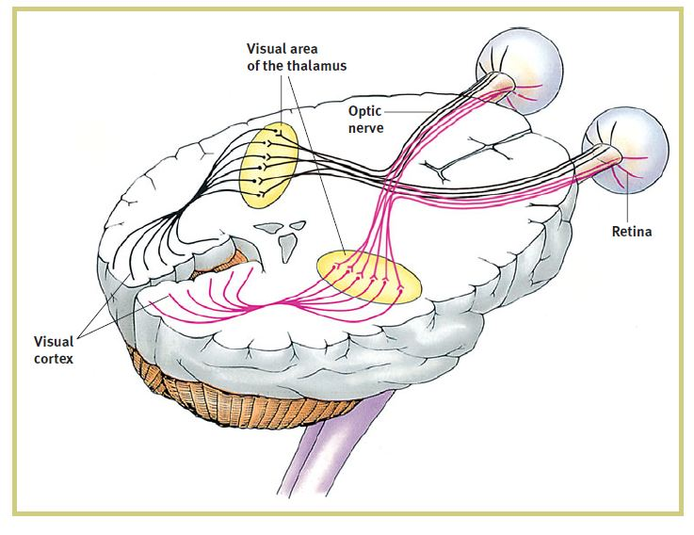
Vision: Eye

Slide 13
6. Vision Light
Spectrum of electromagnetic energy
Vary in wavelength
Human eyes can perceive only a very thin band of electromagnetic waves, known as the visible spectrum (400 – 700nanometers)
Within visible light, color is determined by wavelength

Slide 14
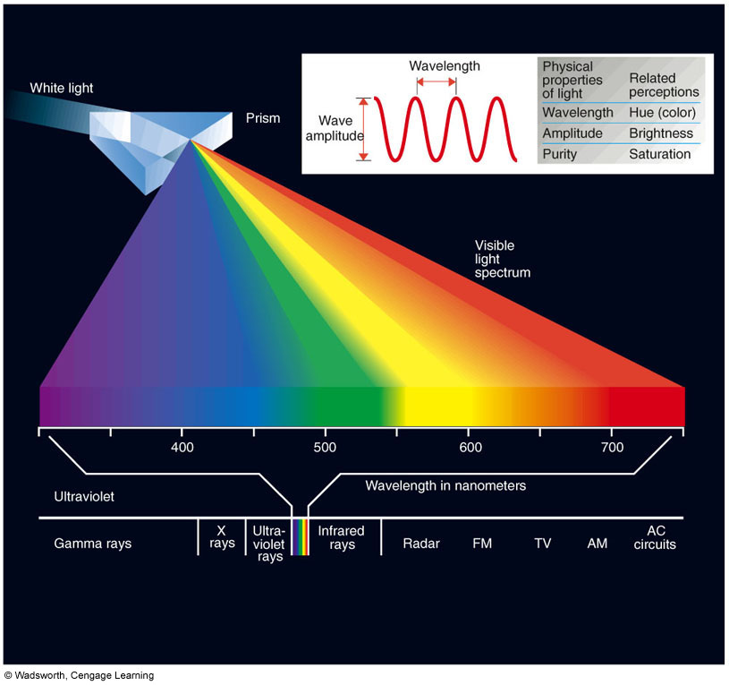
The Visible Spectrum
Notes:
Figure 4.1 The Visible Spectrum. By passing a source of white light, such as sunlight, through a prism, we break it down into the colors of the visible spectrum. The visible spectrum is just a narrow segment of the electromagnetic spectrum. The electromagnetic spectrum also includes radio waves, microwaves, X rays, cosmic rays, and many others. Different forms of electromagnetic energy have wave-lengths which vary from a few trillonths of a meter to thousands of miles. Visible light varies in wave-length from about 400 to 700 billionths of a meter. (A meter = 39.37 inches.)

Slide 15
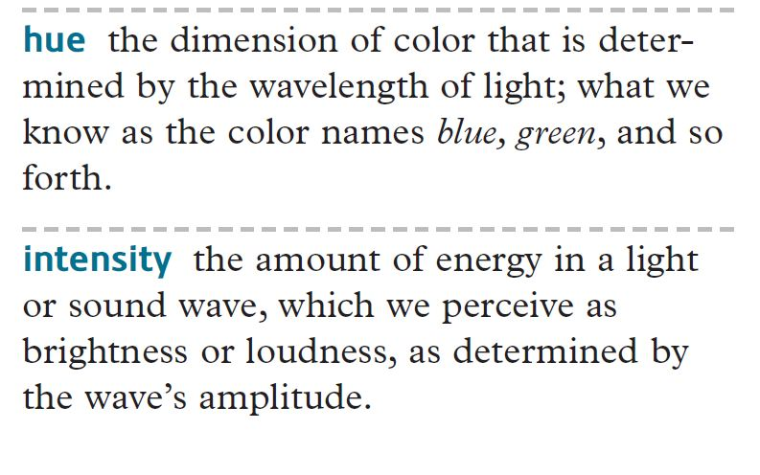

Slide 16


Slide 17
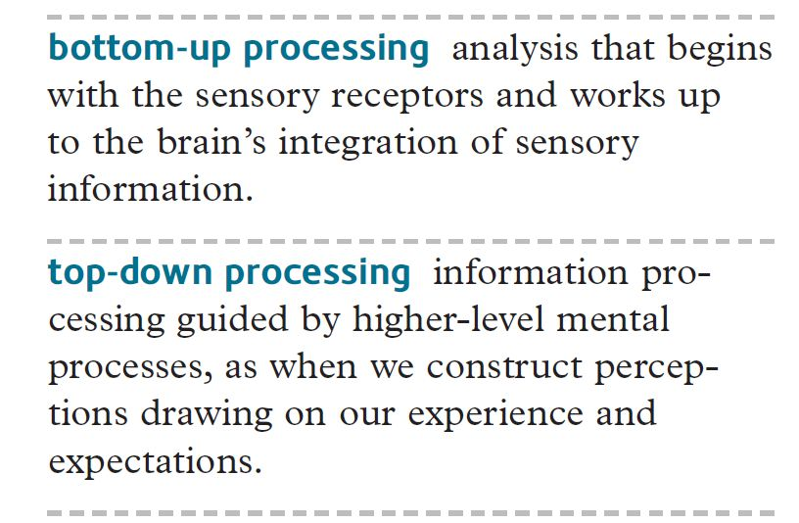

Slide 18
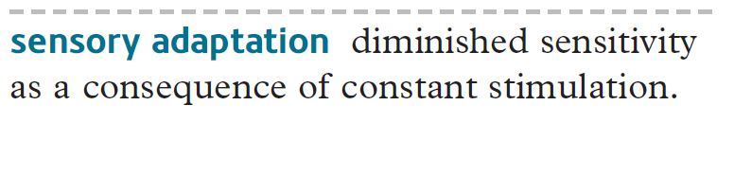

Slide 19
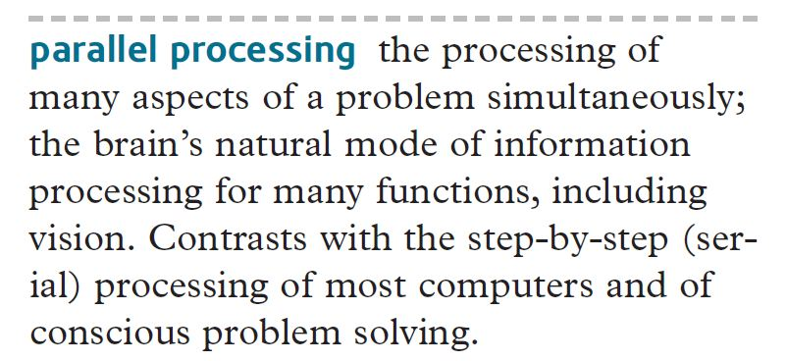

Slide 20
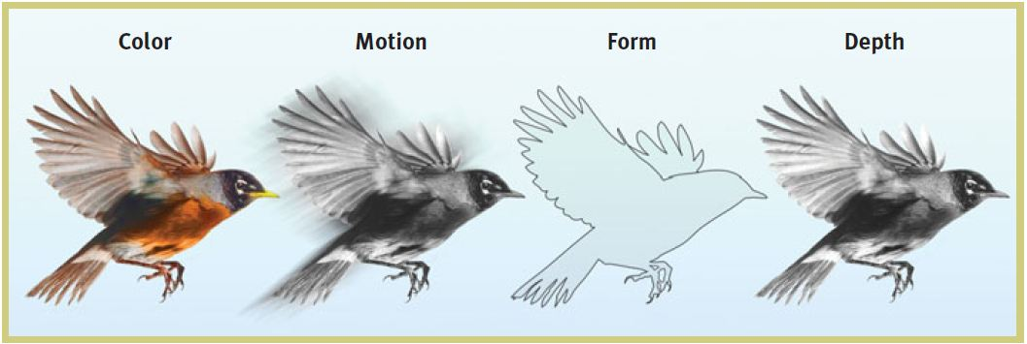

Slide 21
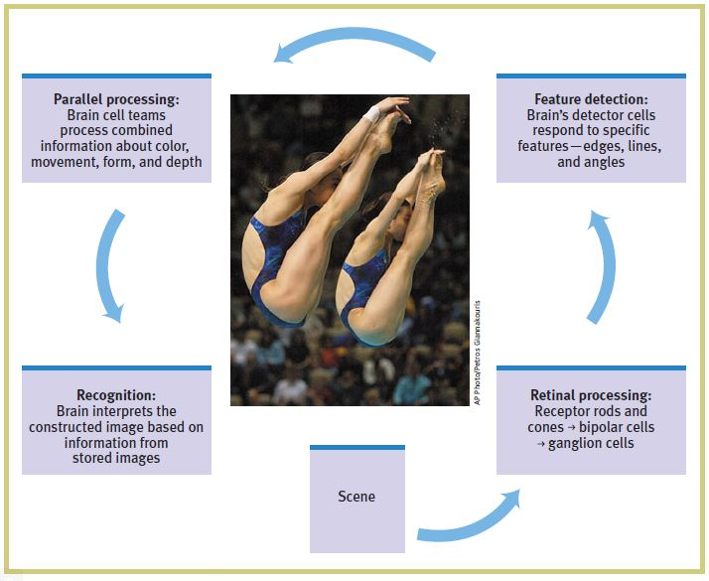

Slide 22
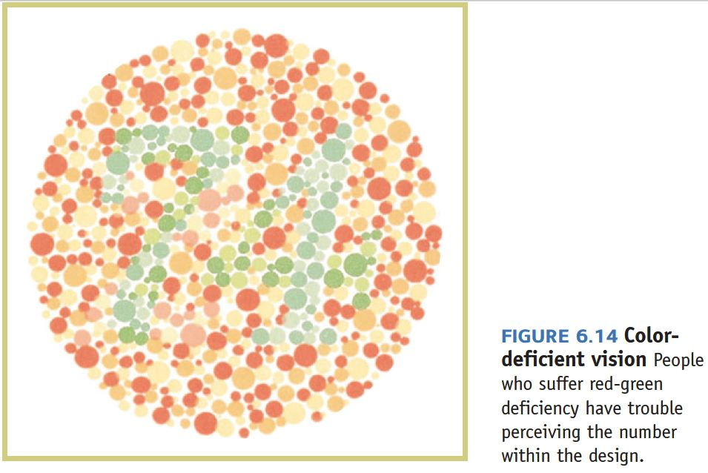

Slide 23
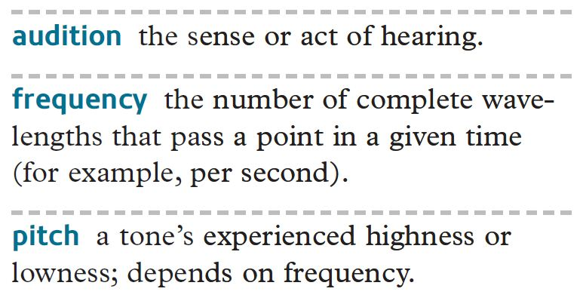
Hearing

Slide 24
9. Pitch and Loudness
Pitch
Frequency (# of cycles per second)
Expressed in hertz (Hz)
Pitch of women’s voice is higher than men’s
Loudness
Height (amplitude) of sound waves
Expressed in decibels (dB)
Notes:
One cycle per second = 1 Hz
Pitch of women’s voice is higher than men’s
Women’s vocal cords are usually shorter
Vocal cords vibrate at a greater frequency

Slide 25
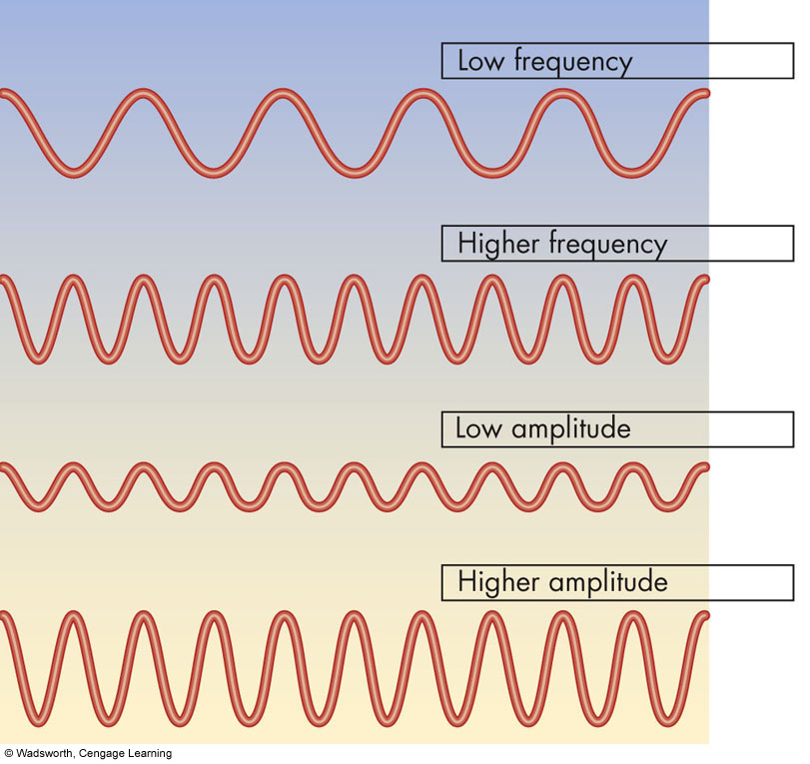
Sound Waves of Various Frequencies and Amplitudes
Notes:
Figure 4.14 Sound Waves of Various Frequencies and Amplitudes. Which sounds have the highest pitch? Which are loudest?

Slide 26
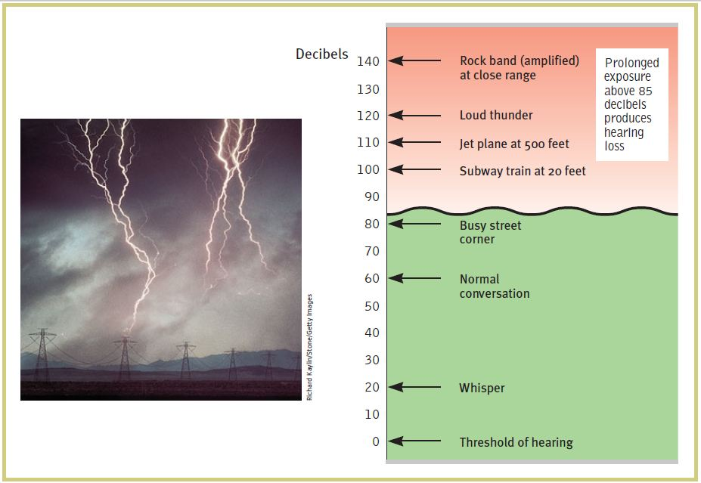

Slide 27
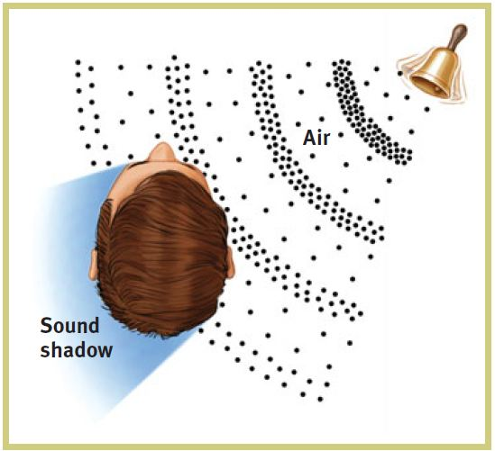

Slide 28
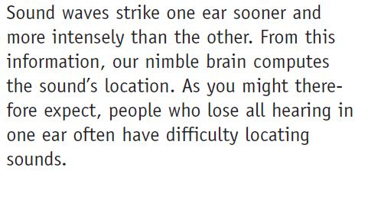

Slide 29
The Skin Senses Touch and Pressure

Slide 30
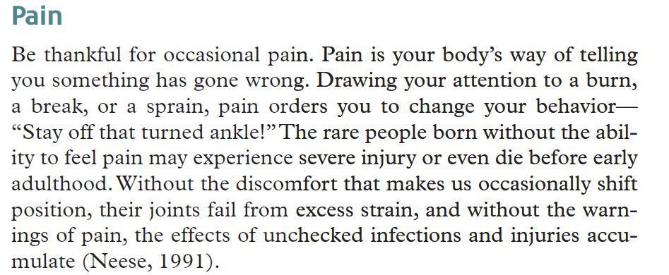
Touch
Touch for Children
Pain

Slide 31
Pain
Nociceptors in skin are stimulated
Pain is usually sharpest where nerve endings are densely packed
Pain can be felt deep within body
No nerve endings for pain in the brain

Slide 32
Touch
The very survival of our species depend on it.
Besides having physical needs for food, cleanliness and shelter, we also have touch needs.

Slide 33
The Importance of Touch
What is the first sense that develops in the womb?
The sense of touch
What is the first language baby understands after being born?
Touch and crying

Slide 34
Cont…
On social level -
Touching helps us to build relationships with one another.
Touch has the potential to heal or break down, nurture or abuse.

Slide 35
Cont…
Emotional level –
Did you know that touch deprivation can be just as damaging as harmful touch?
Touch can comfort us. Reassure us. Relax us. Even arouse us.
Or it could make us very uneasy. Threaten us. Hurt us.

Slide 36
Cont…
Cognitive level –
Touch stimulates brain growth.
Positive touch helps you to cope!

Slide 37
Cont…
Physiological level (touch for child)-
Receiving positive kind of touch will:
regulate a baby's breathing
improve circulation
help in digestion
improve sleep

Slide 38
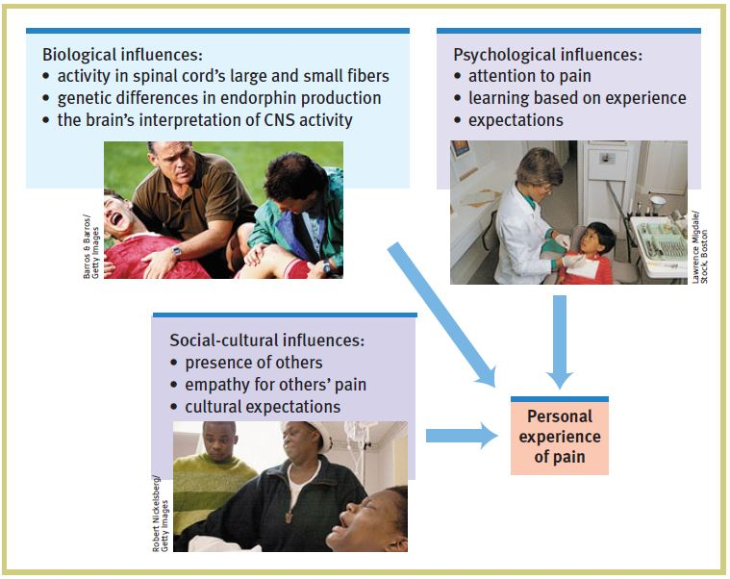

Slide 39
The Chemical Senses: Smell and Taste

Slide 40
Taste
Taste is sensed through taste cells
Receptor neurons on taste buds
Four primary taste qualities
Sweet, sour, salty and bitter
Umami (fifth basic taste) – savory
Flavor of food depends on odor, texture, temperature and taste
Individuals have taste sensitivities

Slide 41
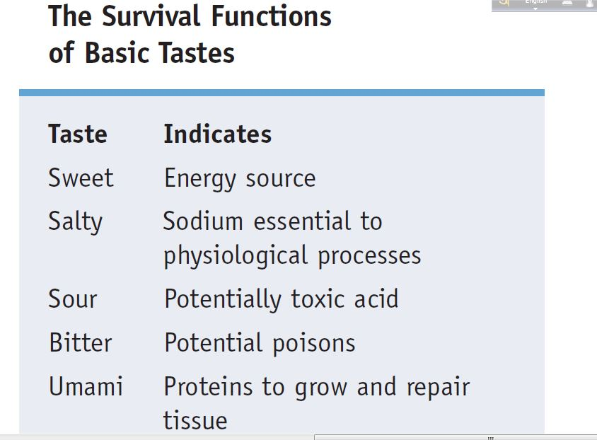
Tastes

Slide 42
Smell
Odors trigger receptor neurons in olfactory membrane
Odors are sample molecules of substances in the air
Sensory information about odors is sent to the brain through the olfactory nerve
Odor contributes to flavor of foods

Slide 43
Smell
For humans, the attractiveness of smells depends on learned associations. After a good experience becomes associated with a particular scent, people come to like that scent.
The smell of the sea, the scent of a perfume, the aroma of loved one’s cloth can bring to mind a happy time

